Slide 1





https://ai4mi.epotentia.com
Hands-on session 2
Steel defect classification with deep learning

Slide 2




Slide 3

What is AI?
Series of techniques to extract information from data

Slide 4
Types of AI
Deep learning
GPU
Performance
Machine learning
Statistics
CPU
Amount of information
The more data we have, the more we trade insight for predictive power

Slide 5


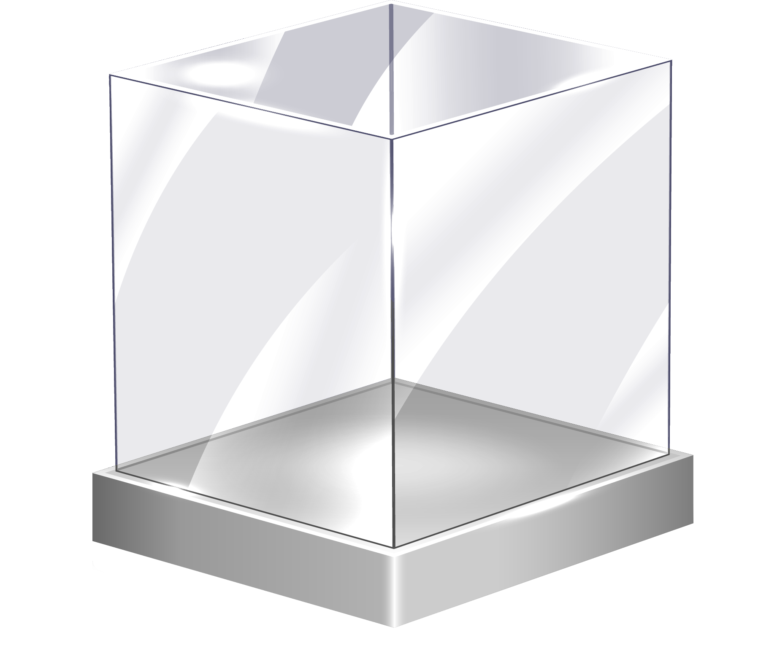

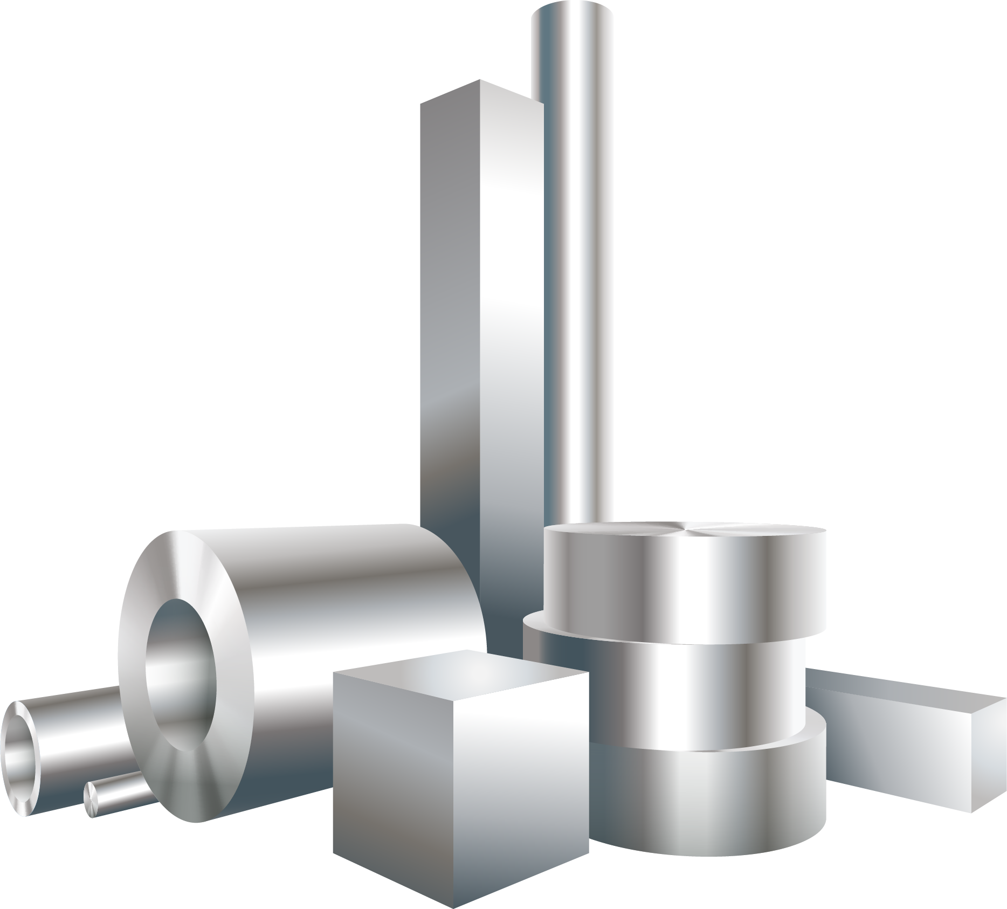



Case studies
Glass
Spreadsheet data
Steel
Materials discovery
Manufacturing
Computer vision
Sensor data

Slide 6
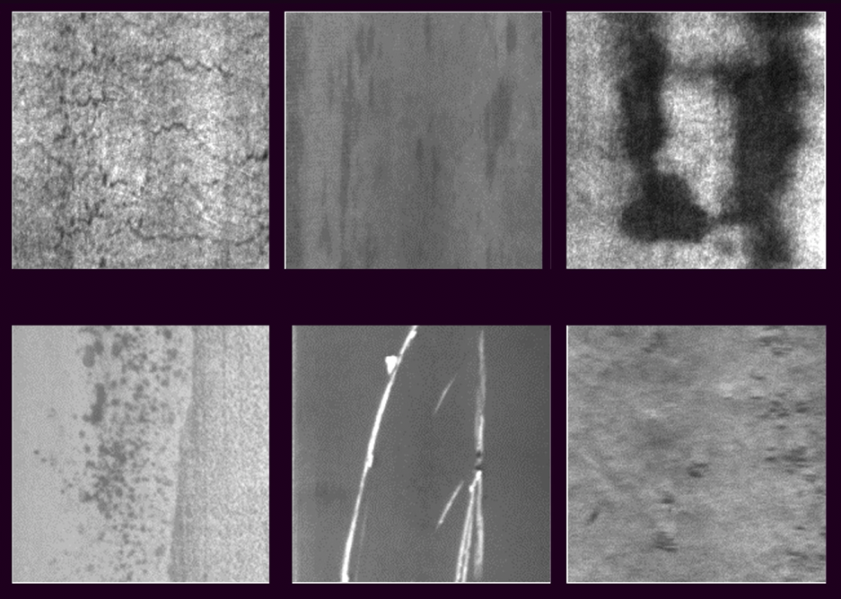
Steel plate defects
Crazing
Inclusions
Patches
Rolled-in scale
Scratches
Pits

Slide 7
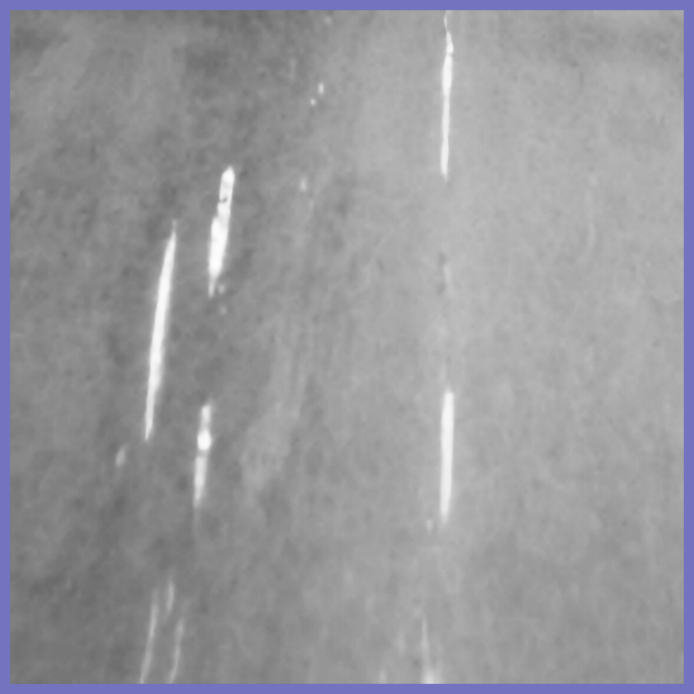
Multi-step pipeline
Detector
Featurizer
Classifier
Can we make a model that classifies the raw image directly?

Slide 8

Neural networks
Source: wikipedia
Inspired by nature

Slide 9
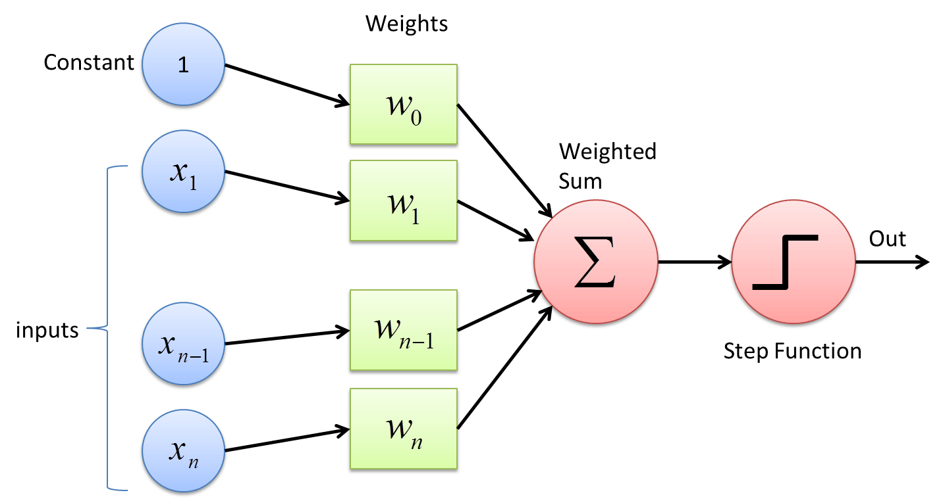
Artificial neurons or perceptrons
A perceptron is equal to linear or logistic regression

Slide 10
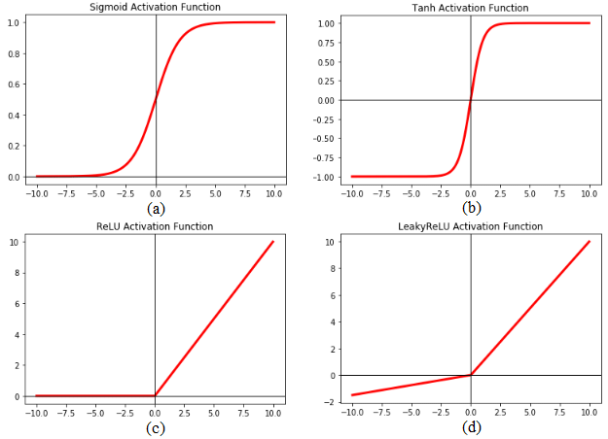
Activation functions
1
Sigmoid
Relu
Using non-linear activations any function can be approximated

Slide 11
Convolutional layers
Convolutional filter
Convolutions allow us to filter using less parameters and have symmetry!

Slide 12
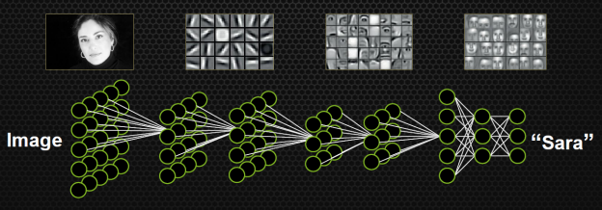
Deep learning
Source: NVIDIA Deep learning training
Features are engineered for you! but need lots of data… or do you?

Slide 13
Transfer learning
Feature generation network
Output
Source: NVIDIA Deep learning training
With transfer learning we train on large datasets and finetune on small ones

Slide 14
Residual networks
Activation
Convolution
batchnorm
ReLU
Skip connection
Convolution
batchnorm
ReLU
out
Activation + out
Normalization and skip connections stabilize training

Slide 15
This session
Analyze the images
Choose a model
Optimize the model
Evaluate the results
Interpret with explainable AI
Part of the pipeline needs to run in production

Slide 16
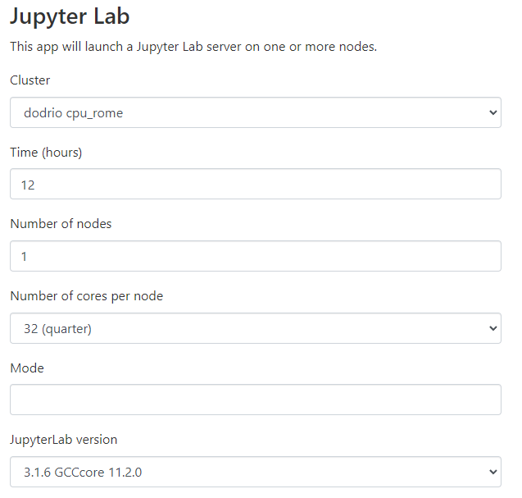
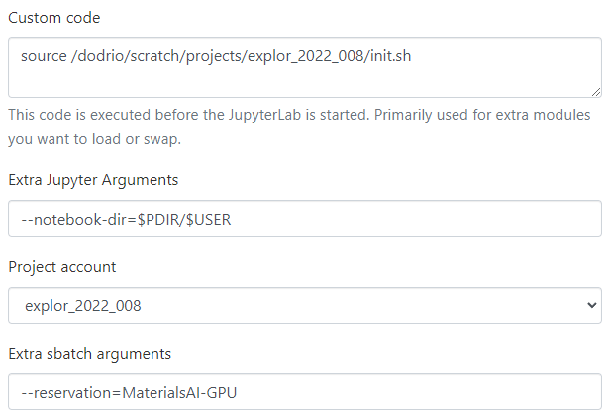
Requesting a job
Log in at https://tier1.hpc.ugent.be

Slide 17
Training a neural network
Batches should contain enough variation

Slide 18
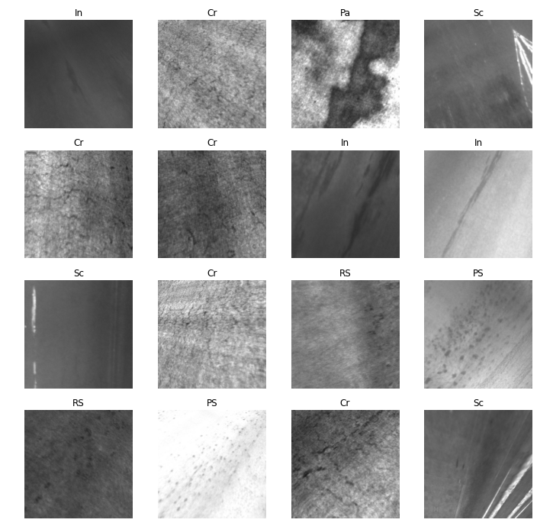
Augmentation
Adding some distortion to images improves our model’s robustness

Slide 19
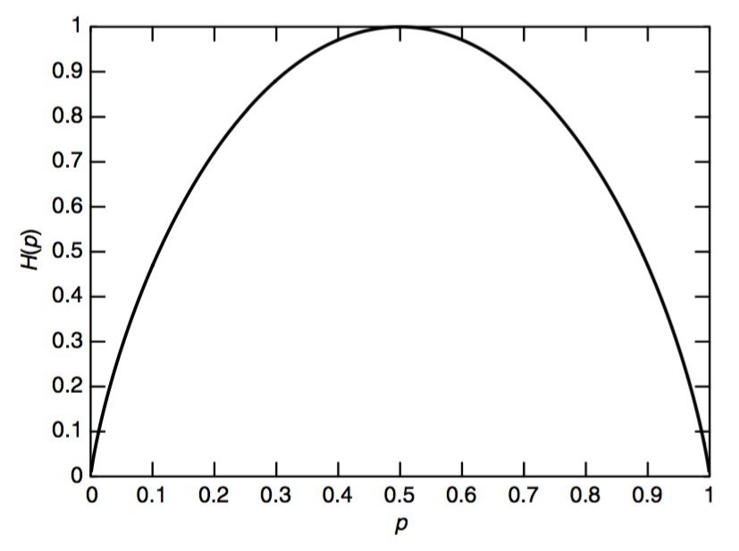
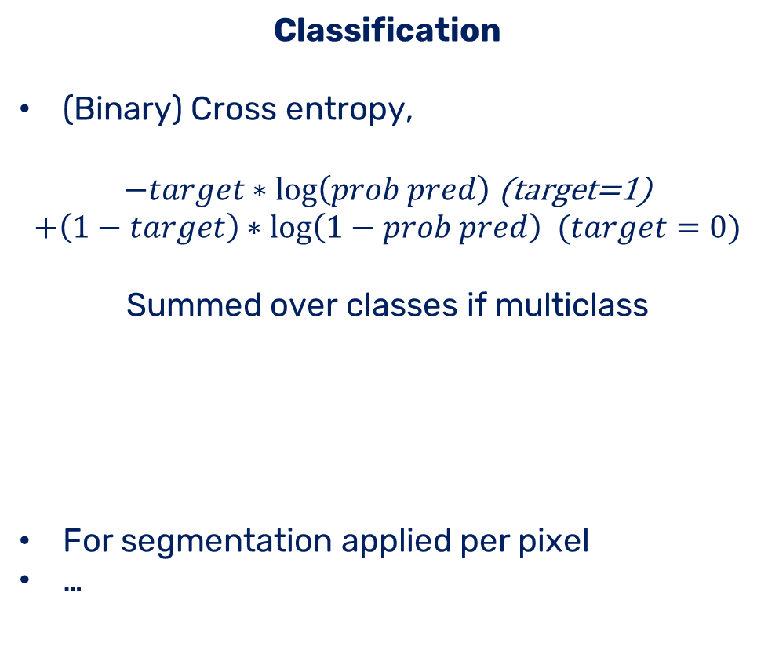
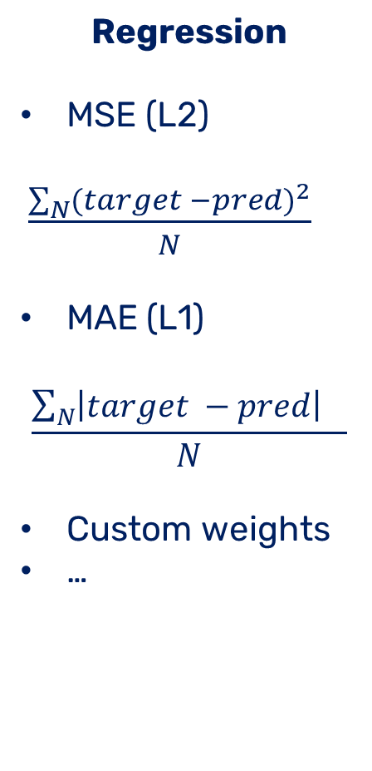
Loss functions
Regression
MSE (L2)
$\frac{\sum_{N}{{(target −pred)}^{2}}}{N}$
MAE (L1)
$$\frac{\sum_{N}{{\left|target −pred\right|}^{}}}{N}$$
Custom weights
…
Classification
(Binary) Cross entropy,
$−target∗\log\left(prob pred\right)$ (target=1)
$$+\left(1−target\right)∗\log\left(1−prob pred\right) (target=0)$$
Summed over classes if multiclass
For segmentation applied per pixel
…
The right metric guides the optimizer to the right goal

Slide 20
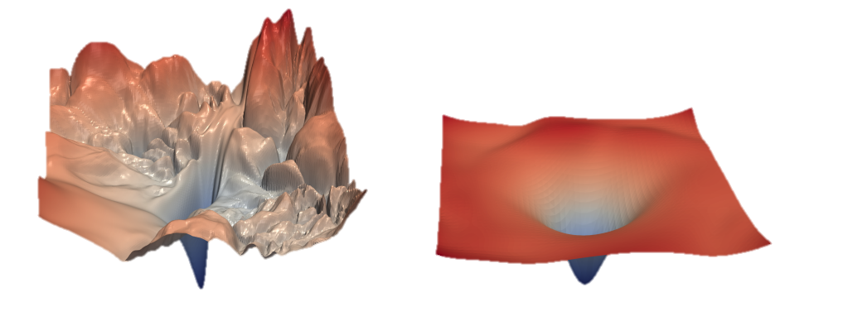
Loss surfaces
Resnet
Normal net
https://proceedings.neurips.cc/paper/2018/file/a41b3bb3e6b050b6c9067c67f663b915-Paper.pdf
https://izmailovpavel.github.io/curves_blogpost/
Loss functions have complex surfaces with millions of parameters

Slide 21
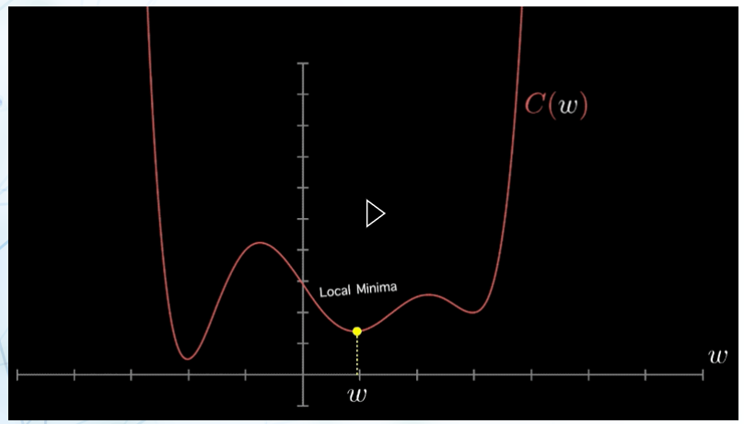
Optimizing
3blue1brown - https://mlfromscratch.com/optimizers-explained/#/
Gradient descent allows us to stepwise optimize our parameters for our loss

Slide 22
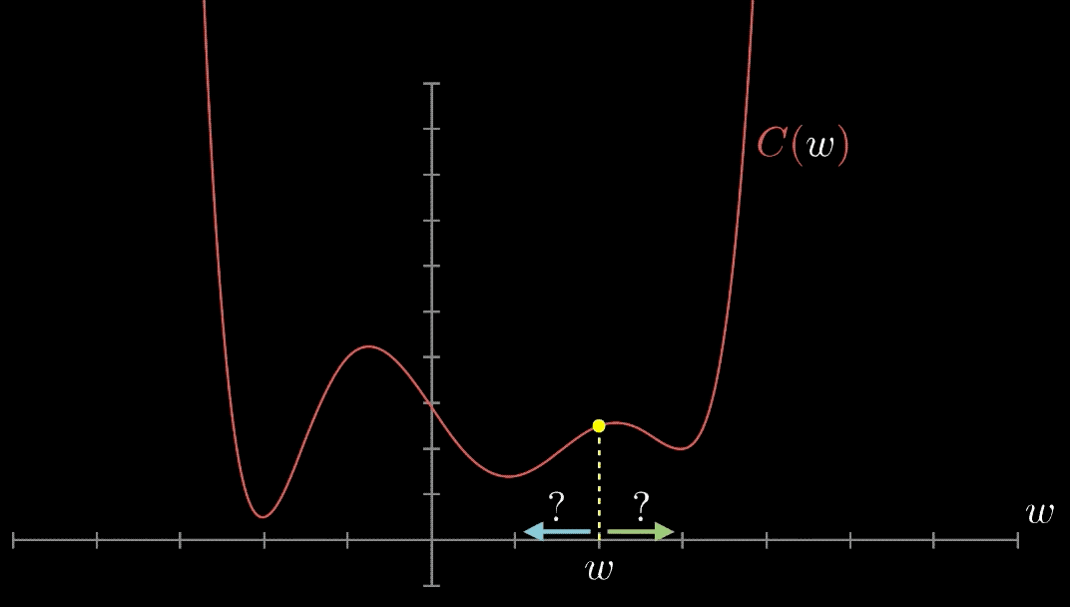
Optimizing
3blue1brown - https://mlfromscratch.com/optimizers-explained/#/
Gradient descent allows us to stepwise optimize our parameters for our loss

Slide 23
More on optimizers
https://distill.pub/2017/momentum/ - try this yourself
https://ruder.io/optimizing-gradient-descent/
https://towardsdatascience.com/a-visual-explanation-of-gradient-descent-methods-momentum-adagrad-rmsprop-adam-f898b102325c
https://towardsdatascience.com/understanding-backpropagation-algorithm-7bb3aa2f95fd
Adding some distortion to images improves our model’s robustness

Slide 24
Regularization
Dropout
Weight decay
Randomly delete neurons doing training
Add the norm of weights to loss

Slide 25
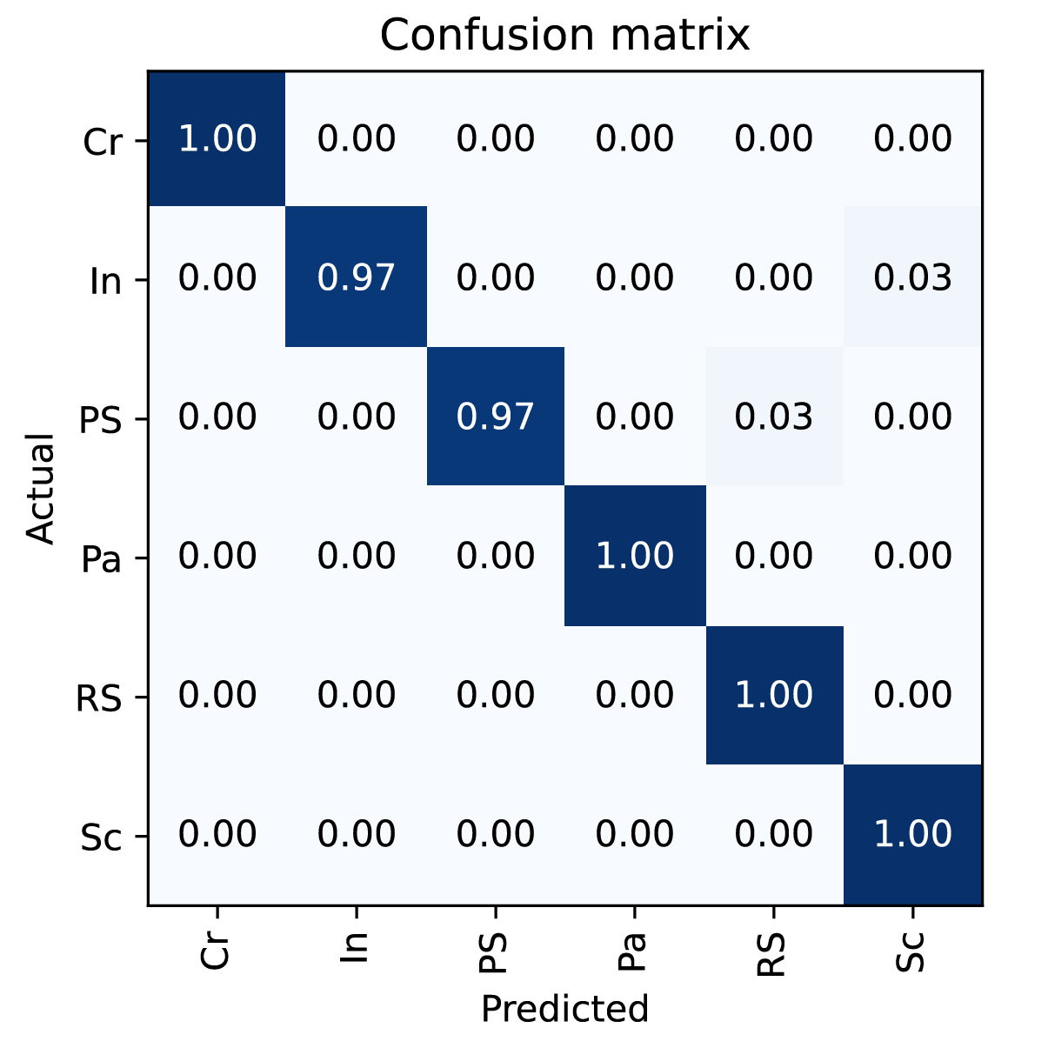
Metrics
Metrics can, but don’t have to be the same as a loss function (no backprop)

Slide 26
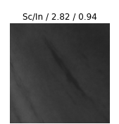
Top losses
Predicted
Actual
Loss
Probability
The best guess is not necessarily a good guess

Slide 27
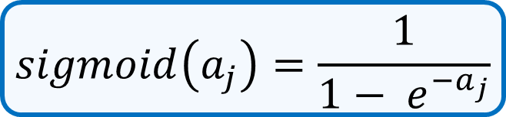
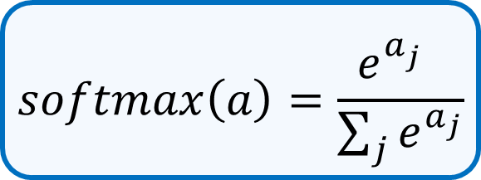
Top losses
Softmax
Sigmoid
1
1
8
1
1
8
$$softmax\left(a\right)=\frac{e^{a_{j}^{} }}{\sum_{j}{e^{a_{j}}}}$$
$$sigmoid\left(a_{j}\right)=\frac{1}{{1− e}^{−a_{j}}}$$
0
0
1
0.7
0.7
1
Always gives the best prediction
Gives probability per class

Slide 28
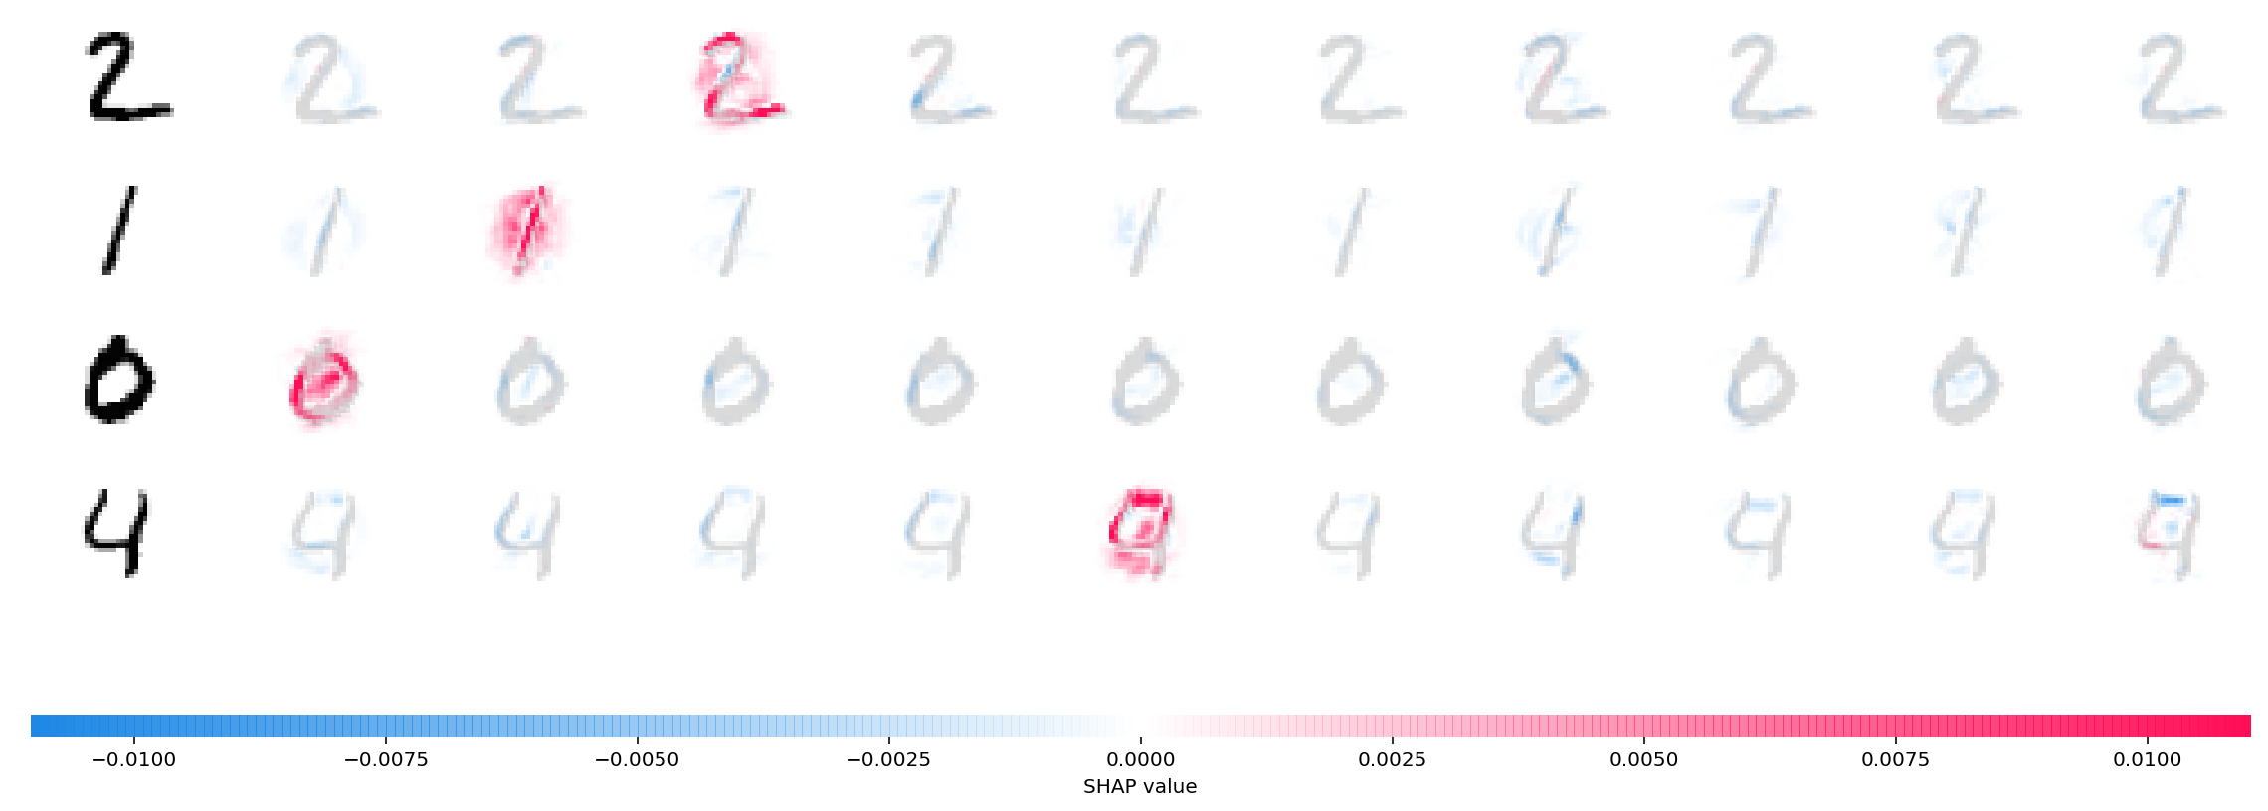
SHAP
Our input features are pixels, can we trace them to the output?
https://github.com/slundberg/shap
Yes, by comparing to baseline images we can approximate shap values using grads

Slide 29
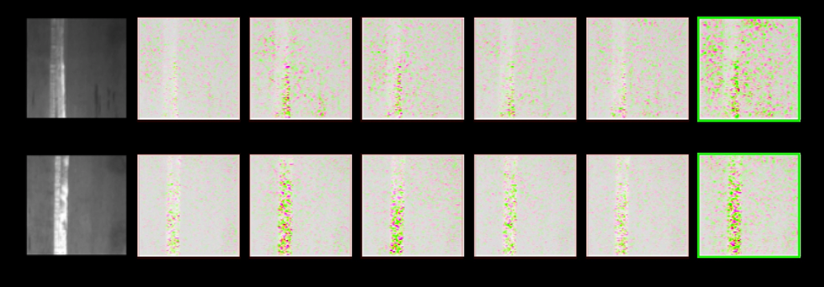
SHAP: scratches
Scratch is clearly highlighted

Slide 30
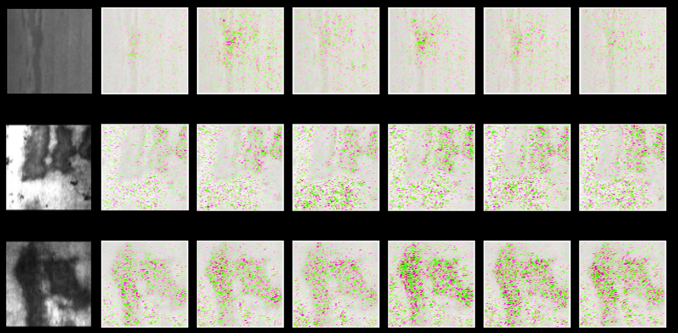
SHAP: large defects
Both dark and light regions used

Slide 31
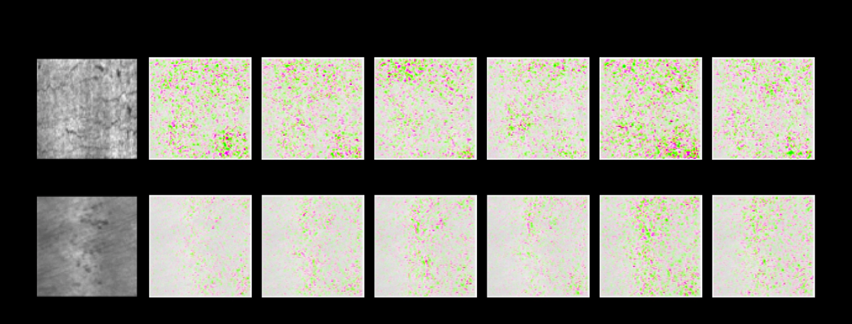
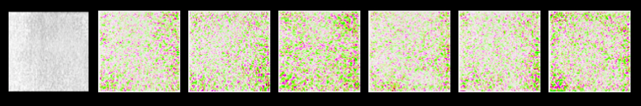
SHAP: distributed defects
Distributed activation regions

Slide 32
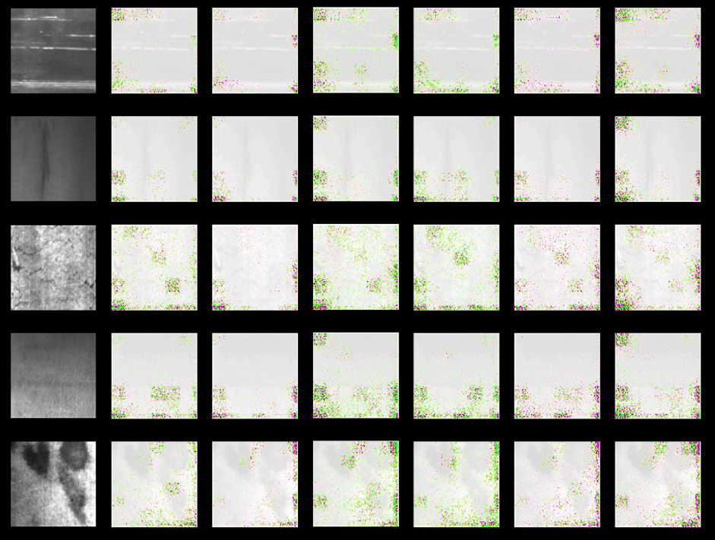
Detecting problems with SHAP
Edges seem more important than they should be

Slide 33
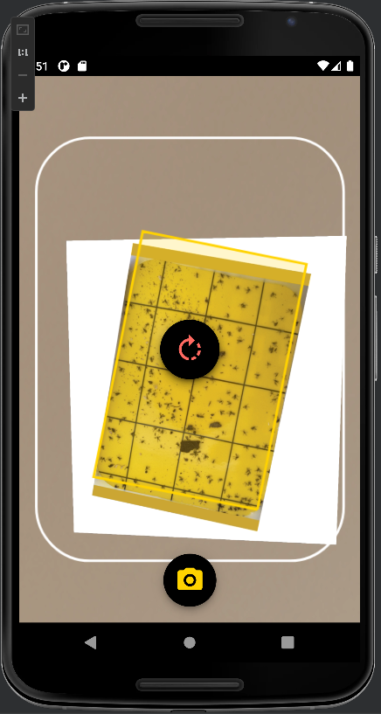
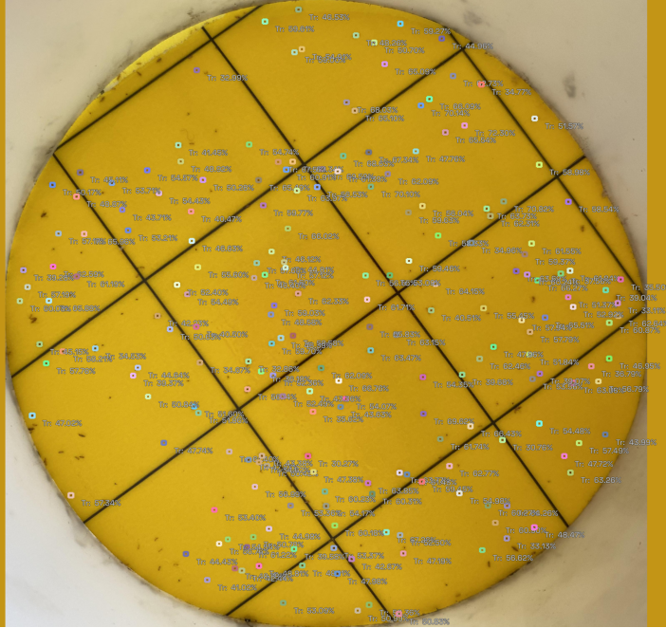
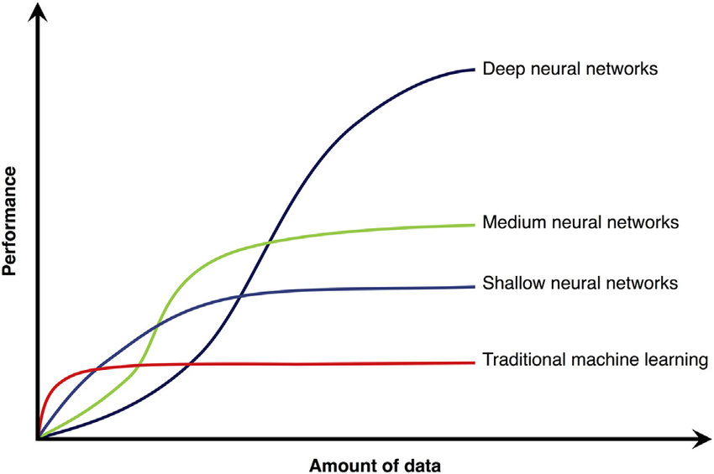
How does this work in production?

Slide 34
How does this work in production?
(Accelerated) Model
API
Queue
(Accelerated) Model
(Accelerated) Model
API lets users schedule tasks for the model

Slide 35

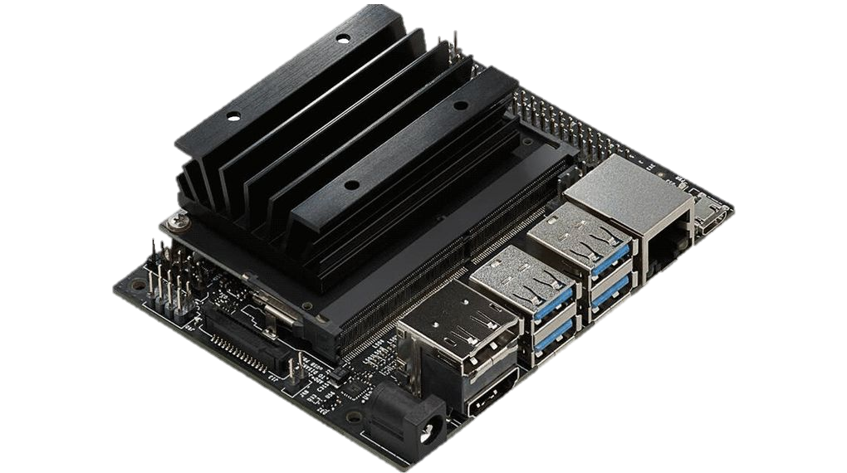



How does this work in production?
Cloud
(VSC, Google, Azure, AWS)
Edge
Cloud allows global deployment, but requires communication

Slide 36





View more online
https://ai4mi.epotentia.com
Glass
Manufacturing
Materials discovery
Sensor data
Sensor data

